Slide 1

DriverPass System Analysis
Jacob Rethmeier
Notes:
[No speaker notes required for this slide.]

Slide 2

System Requirements
Throughout analyzing the features that DriverPass wants to offer they want a system that will :
Offer multiple different packages available to the students/customers
A web based system that can run on any system with internet access computer/mobile and on multiple browsers
Provide students with classes/exams/on-the-road training to better their driving skills and knowledge
A secure fast running site
Appointment scheduling with review notes by the instructors
Testing that updates in unison with DMV to be compliant with their rules/laws
Notes:
Speaker Notes: The system requirements is split up into both functional and non-functional requirements.
The non-functional requirements would include keeping the information provided to students up to date with DMVs regulations.
It would also include the system performing at a quick speed to offer a streamlined experience for the user.
The functional requirements would include providing multiple packages for the user to select.
As well as it should allow the users to view the available dates on the calendar and make an appointment.

Slide 3
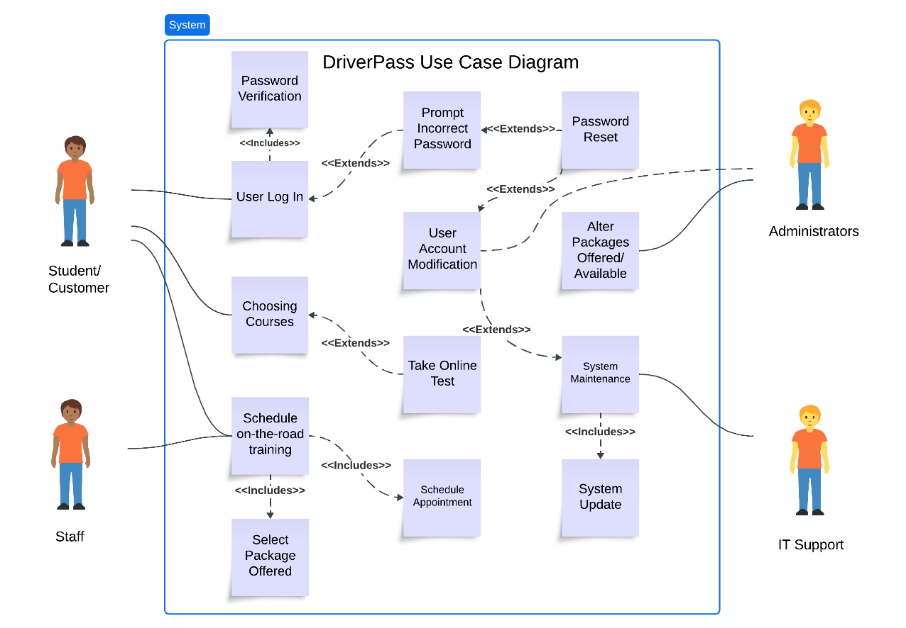
Use Case Diagram
Notes:
This diagram displays who the different users of the system will be, it includes the students, the staff, the administrators and the IT support as well.
Each user in the system will have different roles and accessibility based on those roles.
The basics of each role for the users will be:
Students who will log into their account will choose their package, take test/classes, and schedule appointments for in person training.
Staff who will verify the appointments and schedule them in the calendar with the instructor(who is included in the staff) and provide comments for the student.
IT support will focus on the overall maintenance of the system and the updates.
Administrators who will be able to modify packages offered, reset user passwords, modify/block/delete accounts and will get any vital notifications.

Slide 4
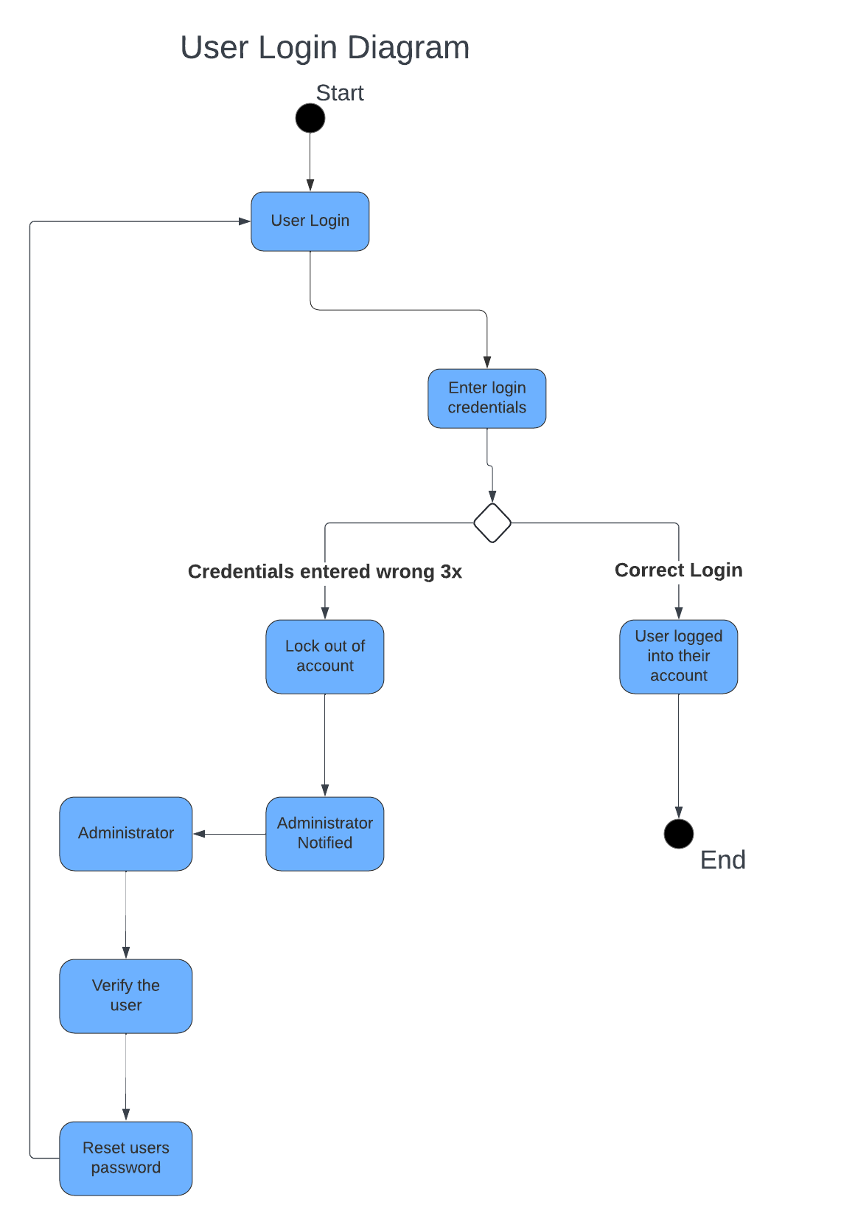
Activity Diagram
Notes:
This diagram breaks down the amount of activity necessary for users to log in to their account.
There will need to be a log in page with prompts for username and password.
Once the user enters these they will need to be checked with their information in the database to see if it matches.
If it does then the user will be logged in to their account and their personal classes/grading will be available.
However if they enter an incorrect password they will be looped back to enter it again.
If they fail three times then the administrator will be notified to assist in the process.
The admin will need the user to verify who they are and upon such they will be able to reset their password.

Slide 5
Security
DriverPass wants all their users information to be safe and to address that the system will:
Prevent brute force hacking attempts by limiting the amount of log in attempts and notifying the admin who can block/delete the account if necessary.
The connection between server and client will be encrypted to secure the data being transferred between the two.
The system will be updated frequently to avoid any bugs or issues that could interfere with security.
The admin will be notified of any events out of the ordinary.
Notes:
The security design was consistently kept in mind throughout the analysis and design phase.
The first security implement is limiting the amount of log in attempts in order to prevent any brute force hacking by letting the user enter as many possibile combinations.
The second security implement will be using HTTPS which is Hypertext Transfer Protocol Secure to encrypt the data being transferred, so even in the unlikely case of intercepted data sensitive information will be encrypted and secure.
The third security implement will be to keep the system updated and compatible with the latest browsers/systems/programs in order to prevent any bugs occurring.

Slide 6
System Limitations
There are some limitations to the system which include for the user to have a stable internet connection to interact with the system functions
Budget, time and priority of functionalities will need to be considered
Vehicle limitations, DriverPass only has 10 cars currently so there may be issues with being booked for long periods of time
Remain in compliance with DMV standards will require consistent research on their regulations for testing
Notes:
Overall there are few limitations to the system discussed but the ones to keep in mind would be:
Consider the time deadline, and the budget to list out the most important functionalities to prioritize.
Potentially consider acquiring more vehicles depending on the volume of students/appointment.
How to be notified about DMV driver test updates.

